Slide 1
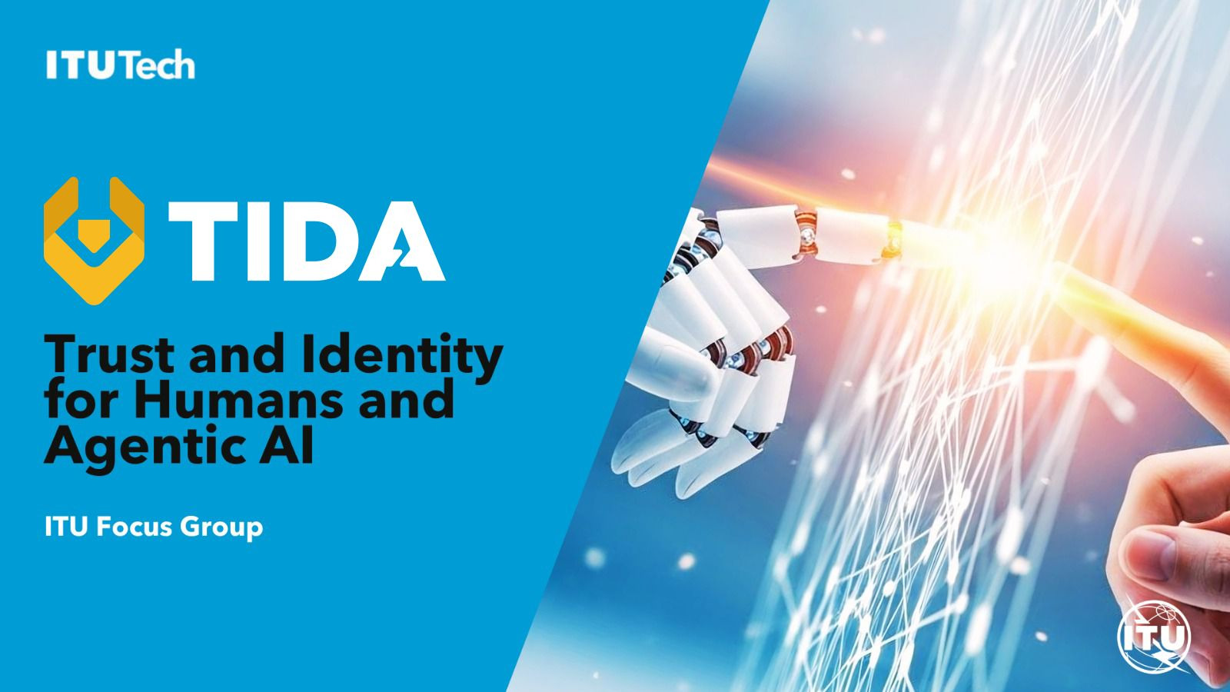
Auto-reporting tools

Slide 2

Agenda
Plans for the 1st in person meeting in Paris, UNESCO building, 30th Nov – 1st Dec
What’s new since last call of 30th Sept
5 selected themes presentations
AOB and agreement on next steps

Slide 3
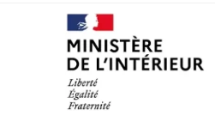


TIDA 1st in person meeting
Paris, 30 Nov – 1 Dec 2026, hosted by the French MoI at UNESCO
Registration via this online form.
Deadline for registration: 20th November. As seats are limited, please register ASAP.
Agenda to be published by 30th of October
Practical information available here (hotel, visa, transportation, weather etc.)

Slide 4
NEW! GitLab mirror to our GitHub
Not every country can access GitHub.
We want to be inclusive so we propose our GitHub repositories are replicated on GitLab, so that all countries can take an active part in TIDA.
If you do not have access to GitHub, please request GitLab access from the FG-TIDA Secretariat, ITU, for approval. Send an email to tsbfgtida@itu.int giving the reason for your request and the email address you want us to grant access to.
Before submitting your request, please make sure you have already created your GitLab account.
GitLab URL: https://www.itu.int/itad/gitlab/

Slide 5
NEW! TIDA ppt available in GitHub
We have added a new folder with slides on TIDA that you can reuse to present this community’s work, so you don’t have to start from scratch.

Slide 6
Let us brainstorm together on ideas for Working Groups
Reminder: Fix WGs by Nov 30th

Slide 7
Selected presentations on proposed themes
  Theme #2: [Sovereign Discovery] ++ Modularity
  Theme #18: [Theme] Trustworthiness of multi-objective agentic AI: a collective-choice formalism
  Theme #13: [Theme] Ecosystem-level Agent Defense
  Theme #29: [Theme] The Should Problem: governed connection decisions across organisational boundaries
  Theme #16: [Theme] Operational Human Oversight Integration for Agentic AI Trust Systems
Notes:
Approach bottom up → what we need from you

Slide 8
5 virtual meetings from now to 30 Nov -1 Dec
29th of July @2pm CET
2nd of September @2pm CET
30th of September @2pm CET
(today) 14th of October @3pm CET
4th of November @2pm CET
Notes:
Approach bottom up → what we need from you

Slide 9

Engage in our GitHub space!
TIDA · GitHub
Notes:
Open the Terms of Reference

Slide 10
THANK YOU FOR YOUR PARTICIPATION

Slide 11
Why creating TIDA?
As AI agents begin to negotiate, transact, and act autonomously on our behalf, the world lacks common international foundations to establish who these agents are, when they can be trusted, and how humans remain in control: FG-TIDA was created to build that foundation before agentic AI becomes ubiquitous
Our objective is to define architectural models and interoperability frameworks that establish trust in agentic AI.
As part of the UN, we bring together an inclusive, global community of Member States, academia, and industry to build this foundation together.

Slide 12
What is a Focus Group in ITU?
TIDA Focus Group is
An Open Community (no need to be member of ITU to participate)
conducting pre-standardization work

Slide 13
Pls subscribe to our Mailing List
Please subscribe to the mailing list here:
https://www.itu.int/en/ITU-T/focusgroups/tida/Pages/default.aspx
→ From Dec 1st I will ONLY use the mailing list to send meeting invitations

Slide 14
What is happening next?
7 Sep 2026
2nd SG17 Content Week, Chongqing (China)
Two SG17 workshops: ITS/CAV security · Secure Agentic AI
7 Oct 2026
Interim SG17 plenary (virtual)
Progress checkpoint
30th Nov –1 Dec 2026
FG-TIDA 1st meeting, Paris
With the Digital Trust Convention at the OECD on 4 December
9 Dec 2026
Interim SG17 plenary (virtual)
Progress checkpoint
25* Jan 2027
SG17 workshop, Geneva
Open to all participants
26 Jan 2027
FG-TIDA meeting, Geneva
Focus Group working session
18–29* Jan 2027
6th SG17 Plenary, Geneva
Next full plenary

Slide 15
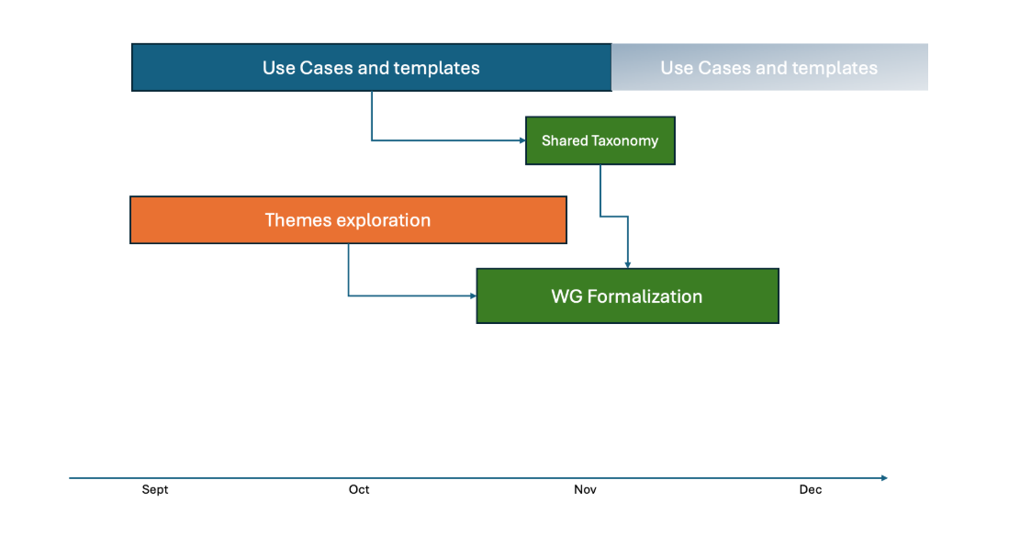
Our timeline for 2026
Notes:
Open the Terms of Reference

Slide 16
Our Objective for 30th Nov – 1st Dec meeting
Formally announce the Focus Group's structure and leadership
Publish an initial definition of deliverables on GitHub
Advance the technical work during the in-person meeting
Notes:
Approach bottom up → what we need from you

Slide 17
Current TIDA Structure

